Slide 1
TerraTournament
©Pescarii
BESTEM 2022

Slide 2




TerraTournament
Tim & Dave

Slide 3
TerraTournament
COUNTRY
Make you learn new things along with your friends.
Help you discover new great places.
Have an intuitive and friendly User Interface
A fun real-time trivia game.

Slide 4
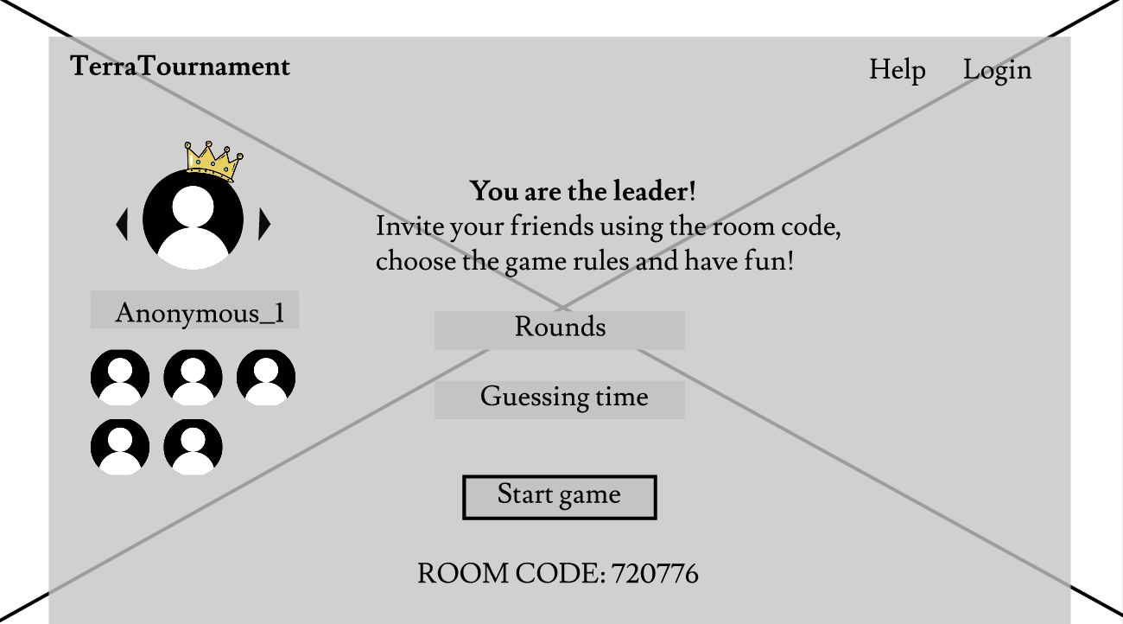
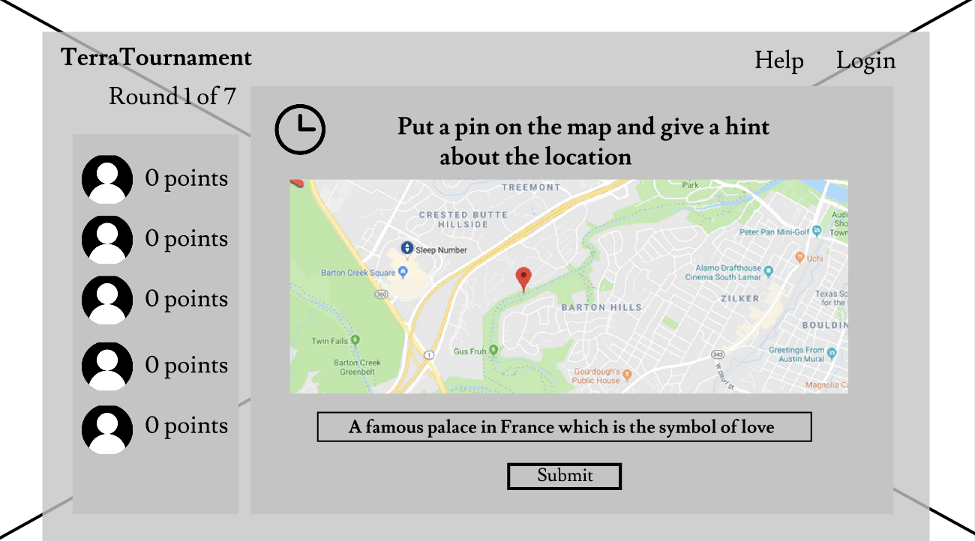
TerraTournament
COUNTRY
Invite your friends!
Challenge your friends!
Maybe win?!
Choose the rules!
Respond to their challenge

Slide 5


TerraTournament
Things learned
03
Teamwork
New technologies

Slide 6


TerraTournament
Future work
03

Slide 7
COUNTRY
Thank you
+
DEMO

Slide 8
COUNTRY
We hope that this template will return to you as a time, money and reputation.
We hope that this template will return to you as a time, money and reputation.
We hope that this template will return to you as a time, money and reputation.
We hope that this template will return to you as a time, money and reputation.

Slide 9



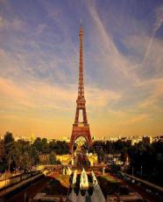
COUNTRY
NOTE HERE
NOTE HERE
NOTE HERE
NOTE HERE
We hope that this template will return to you as a time, money and reputation.
We hope that this template will return to you as a time, money and reputation.
We hope that this template will return to you as a time, money and reputation.
We hope that this template will return to you as a time, money and reputation.

Slide 10
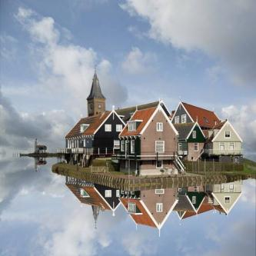

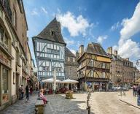

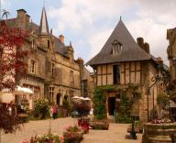

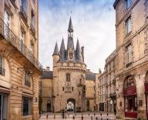
COUNTRY
NOTE HERE
Go ahead and replace it with your own text.
Go ahead and replace it with your own text.

Slide 11

COUNTRY
Go ahead and replace it with your own text.

Slide 12
COUNTRY
We use well-known development methodologies to create a customized approach for each of the projects. This allows us to achieve high quality outcomes and full transparency towards.

Slide 13
COUNTRY
A complex idea can be conveyed with just a single still image, namely making it possible to absorb large amounts of data quickly.
A complex idea can be conveyed with just a single still image, namely making it possible to absorb large amounts of data quickly.
A complex idea can be conveyed with just a single still image, namely making it possible to absorb large amounts of data quickly.
A complex idea can be conveyed with just a single still image, namely making it possible to absorb large amounts of data quickly.

Slide 14
COUNTRY

Slide 15
COUNTRY

Slide 16
Your
A complex idea can be conveyed with just a single still image, namely making it possible to absorb large amounts of data quickly.
04

Slide 17




COUNTRY
STEP HERE
STEP HERE
STEP HERE
STEP HERE
We hope that this template will return to you as a time, money and reputation.
We hope that this template will return to you as a time, money and reputation.
We hope that this template will return to you as a time, money and reputation.
We hope that this template will return to you as a time, money and reputation.

Slide 18
COUNTRY

Slide 19
www.freepptbackgrounds.net
THANK YOU !

